Slide 1
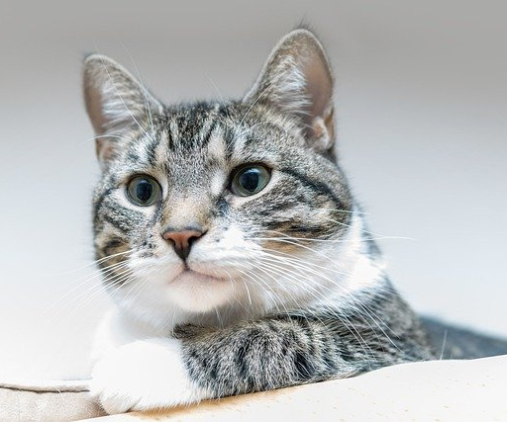
Image Classification
James Schwantes

Slide 2
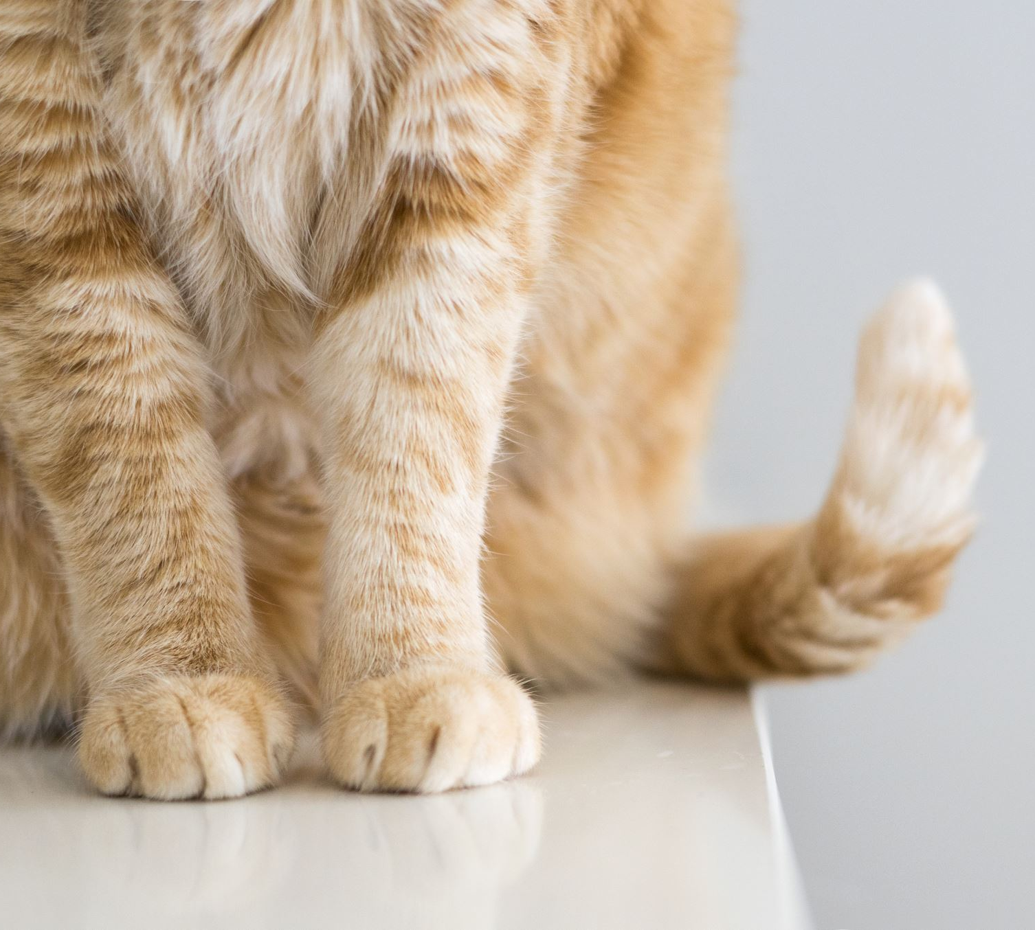
Image Classification
Goal: Classify household cats based on the breed of each cat.
All images with their results were ran against a human being, to determine if the algorithm was accurate, and each image with their result was recorded on an excel spreadsheet.

Slide 3
The Process
I researched into a potential algorithm.
Once the algorithm was found, I copied/tested the algorithm to make sure it worked.
After verifying the algorithm, I modified the algorithm to run multiple images, in a single run.
Once this was complete, I established a goal for classifying cats, and proceeded to build up a database of cat images. In order to run the images through my algorithm.

Slide 4

The Process
Images were found on:

Slide 5
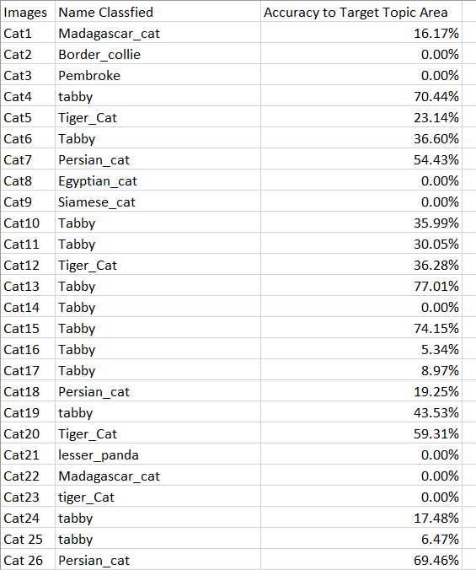
The Process
Results were recorded using Excel:

Slide 6
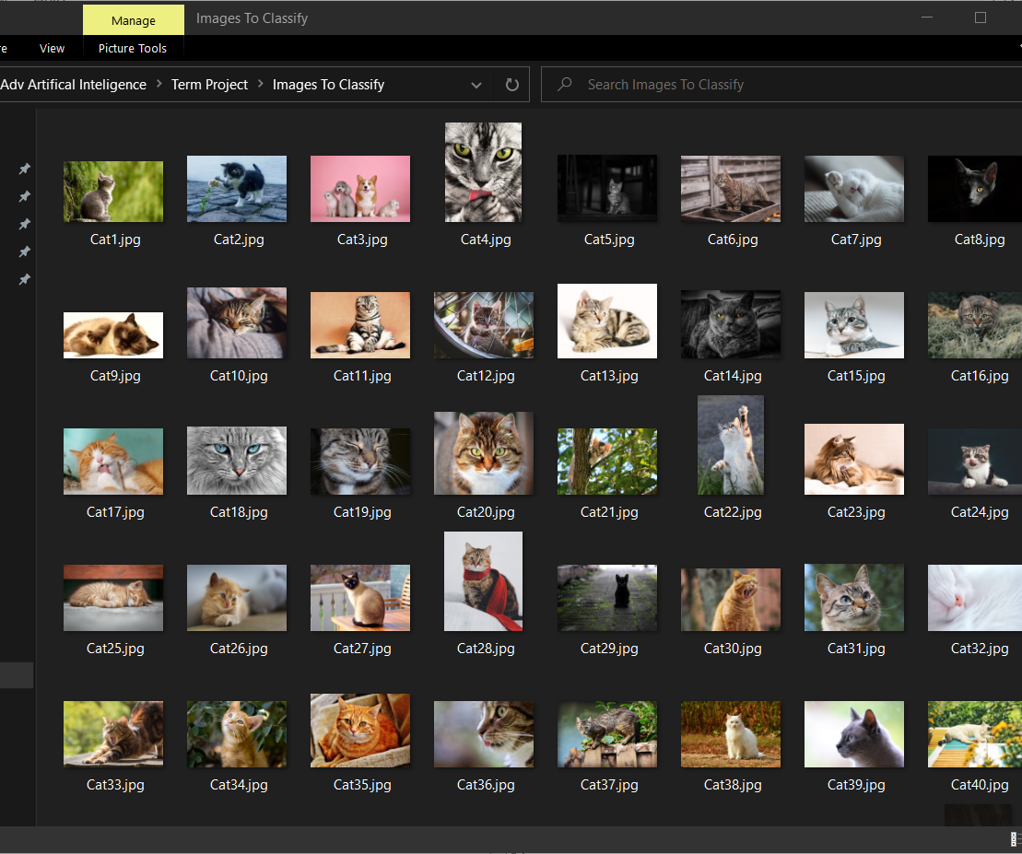
Cat Database

Slide 7
Tools Used
IDE: Anaconda
Spyder
Libraries:
Tensorflow
Numpy
Matplotlib

Slide 8
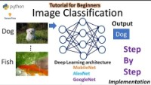
Thank You
DeepLearning_by_PhDScholar!

Slide 9
Live DEMO!

Slide 10
Average Accuracy?
22.37%
What went wrong?

Slide 11
Problem 1:
I only had 200 Images of Cats.

Slide 12
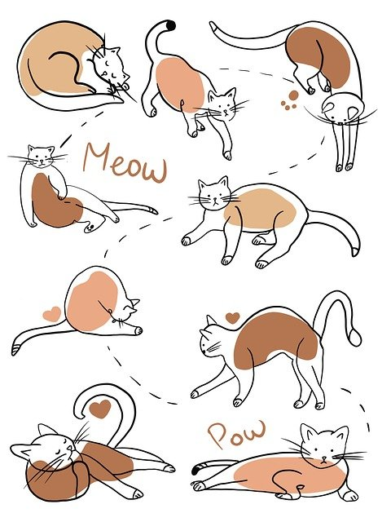
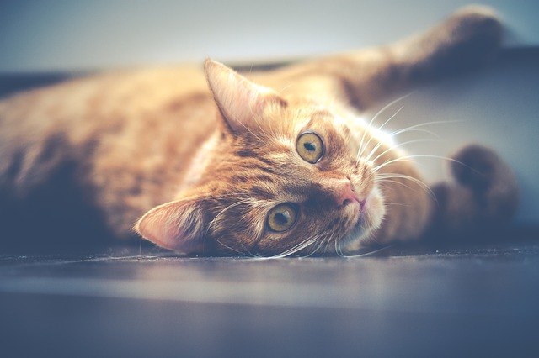
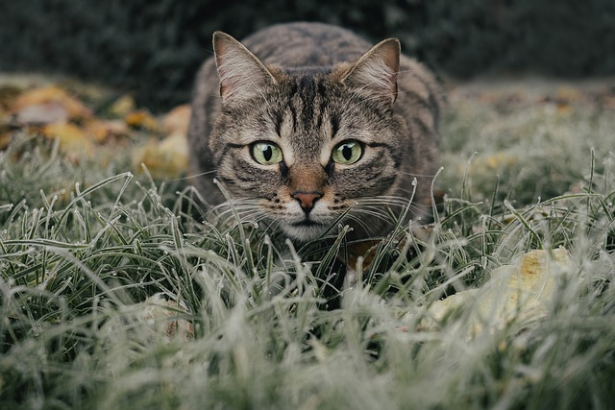
Other Problems
Problem 2: Some of the Images were hard or unfair to classify.
Problem 3: Some of the Images were misclassified due to correlations being made.
Problem 4: Some of the Images had low accuracies because of correlations.
Classification: Tiger Cat
Classification: Tabby Cat
Correct Classification: Tabby Cat
Accuracy: 5.34%
Classification: Jigsaw Puzzle

Slide 13
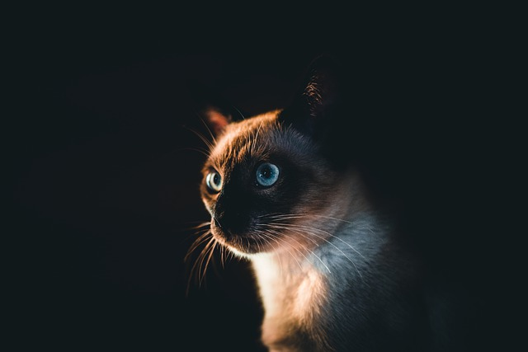
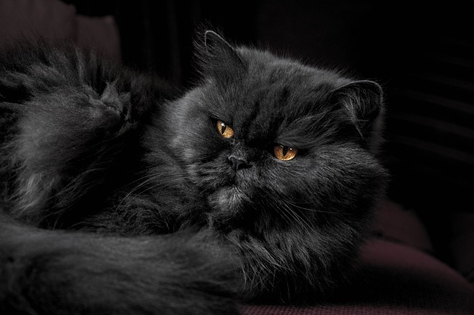
What went well.
I have a working algorithm.
The average accuracy was still high with all things considered.
There were some images that had some high accuracies.
Classification: Siamese Cat
Accuracy: 79.89%
Classification: Persian Cat
Accuracy 99.13%

Slide 14
Inconclusion
Image Classification Algorithms should be used as a tools.
There are some instances where the algorithm was correct.
There were some instances that the algorithm was wrong.
In the end, I think more data would increase the accuracy of the algorithm. Along with having easier photos to work with.

Slide 15
Any Questions?

